Slide 1
Drugstore Location
Couresra capstone project – IBM data science

Slide 2
Introduction
In this project I solved problem of drugstore owner who was interested to establish a new drugstore in US. He/She wants the drugstore to be in the region where most hospitals are located since more hospitals means more patients who need drug.

Slide 3
Data Acquisition
In order to find the best region I used foursquare API to get list of hospitals in 10 most popular city of US. I saved data as json and extracted useful features like name of hospital, city, state lat and lng of the hospitals.

Slide 4
Data Cleaning
After collecting the data, I cleaned it and transformed it to a pandas dataframe that has 300 rows and include name of hospital, city, state, lat and lng of the location.

Slide 5
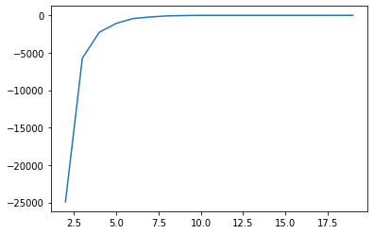
Model
In order to find the region where most hospitals are located I used kmeans clustering to segment the data into 5 region. The reason for k=5 is that with 5 cluster model had the highest accuracy.

Slide 6
Results
After setting k=5 and training the model I segmented all hospitals into 5 regions and and found out that:
Cluster 1 has 30 data hospitals
Cluster 2 has 90 data hospitals
Cluster 3 has 90 data hospitals
Cluster 4 has 60 data hospitals
Cluster 5 has 30 data hospitals

Slide 7
Discussion
Based on the results of previous section I would say the best place for a new drugstore would be within cluster 2 and cluster 3 since most hospitals are located in those area. This project has a lot more that can be improved on, for example maybe cluster 2 and cluster 3 already have many drugstore and a new one won’t work.

